Slide 1
IS4301 Agile IT with DevOps
Tutorial 8

Slide 2
Tutorial Objective
Learn Version control with Git
Create code brunch
Update code brunch
Merge code brunch
Screenshot your progress and submit a report to Luminus

Slide 3
Installing Git
Open Terminal/Console
Check a version of Git:
Git --version
3. If there is none, install Git to your PC:
https://git-scm.com/download/mac

Slide 4
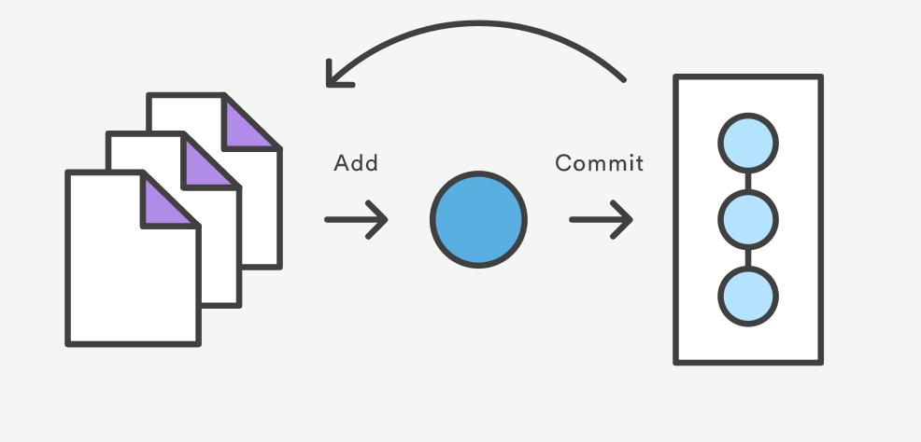
Git basic commands: git add & git commit

Slide 5
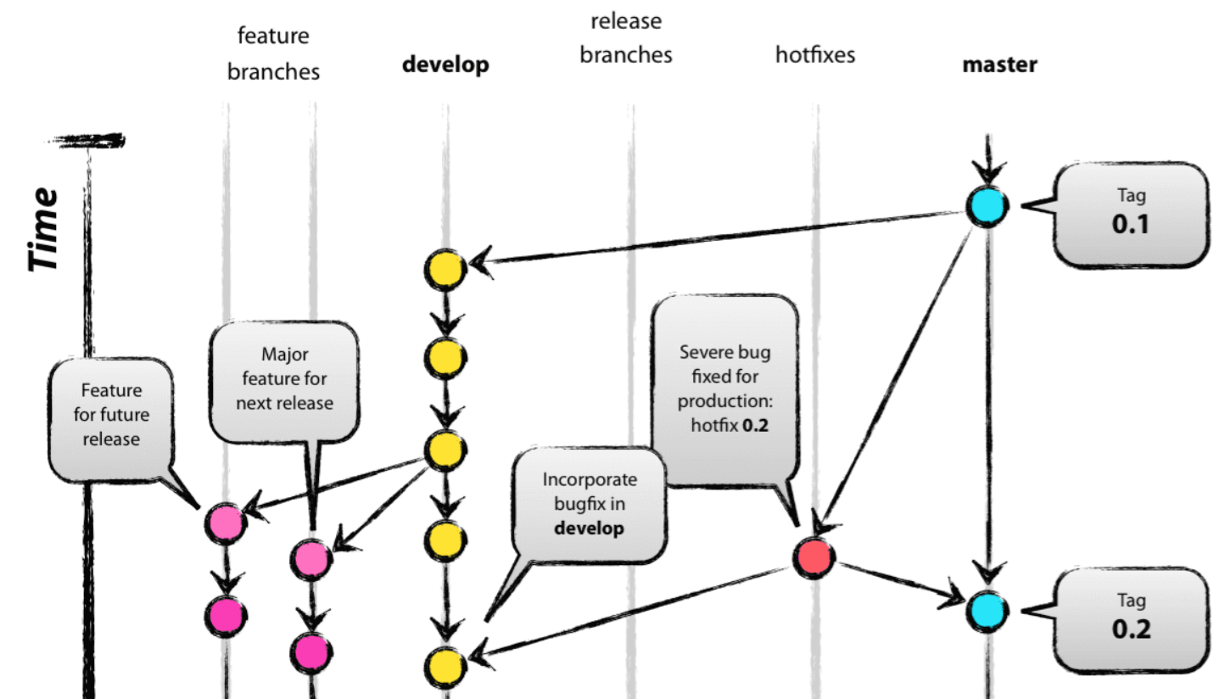
Git basic commands: git branch, git checkout & git merge

Slide 6
Task 1: Create a master branch
Open the unchanged project from the tutorial 7
Initial a git project with branch master:
git init
Add all files to the snapshot:
git add .
Commit the snapshot:
git commit –m “Project Branch”
Check the Git’s current status
git status

Slide 7
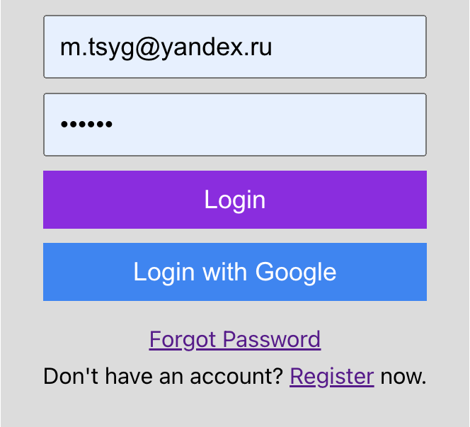
Task 2: Make changes in develop branch
Create a branch develop and switch to the branch:
git branch develop & git checkout develop
Change the css files in the project:
Change color of buttons
Change text:
Font
Size of the objects
Add all files to the branch
git add .
Commit the change:
git commit –m “Project Branch v2”
Check the commit history:
git log --oneline --graph --all –-decorate

Slide 8
Task 3: Add Firebase configuration on newfeature branch
Add a new branch newfeature based on develop branch:
git checkout –b newfeature develop
Change the firebase configuration, as we did last week
Add all files then commit the change
git add .
Switch back to branch develop and merge the new feature onto the develop branch
git checkout develop & git merge --no-ff newfeature
Check the commit history:
git log --oneline --graph --all --decorate

Slide 9
Task 4: Merge develop branch back to master branch for release
Switch back to branch master and merge branch develop
git checkout master & git merge --no-ff develop
Check the commit history
git log --oneline --graph --all --decorate

Slide 10
Key Take-away
Git branch feature provides developers with an isolated environment to make and test changes

Slide 11
Submit your report to Luminus

